Slide 1


Telecom Churn Analysis: Predicting Customer Attrition
In the highly competitive telecom industry, understanding and predicting customer churn is crucial for maintaining a robust subscriber base and ensuring long-term profitability. This capstone project leverages advanced statistical models to uncover the key drivers of customer attrition and equip telecom providers with actionable insights.
by Alfred

Slide 2

Introduction: Significance of Churn Prediction in Telecom Industry
1
Customer Retention
2
Revenue Impact
3
Competitive Advantage
Accurately identifying customers at risk of churning allows telecom companies to proactively implement targeted retention strategies.
Reducing churn rates directly translates to higher revenue and profitability, as acquiring new customers is more expensive than retaining existing ones.
Leveraging churn prediction models gives telecom providers a competitive edge in an industry with high customer turnover.

Slide 3

Table of Content
Agenda
Understanding the Feature
Methodology
Comparative Analysis of Model Performance
Key Finding
Business value proportion

Slide 4

Agenda
Problem Statement :
To develop a predictive model that can accurately identify customers who are likely to churn based on their historical usage patterns, demographic information, and other relevant factors.
Objective:
Predict Churn: Accurately predict which customers are at high risk of churning.
Identify Key Drivers: Determine the key factors influencing customer churn.
Implement Targeted Retention Strategies: Develop and execute targeted campaigns to retain high-value customers.

Slide 5

Understand the Feature
The Dataset has around 19 columns and 7043 rows of data but understanding each feature are so important to get a good model accuracy
New columns has been also created with the existing column for better prediction
It has around 17 Objects, 2 Int, 1 Float DataType for the understanding of the conversation
Notes:
The features we'll be using to predict telecom churn are critical to understand. These features provide insights into customer behavior and characteristics that can help us identify who is at risk of churning. Let's dive into each of the key features we'll be analyzing and how they relate to customer churn. Understanding these features will allow us to build an accurate predictive model to identify customers likely to leave the service. Knowing the most impactful features will guide our data preparation and model development efforts.

Slide 6
Methodology
Data Preprocessing
Data Preprocessing
Exploratory Analysis
Derived features such as Charges Per Month, Contract Payment Interaction, Streaming Movies , Tenure charges etc… are engineered to capture the multifaceted drivers of churn.
Handling Missing Values, Label Encoder, Standard Scaler, Handling Imbalance (SMOTE),
We visually understood about our dataset target variable churn, Correlation with numeric feature with churn that make us understand variable directly are inversely drives the churn rates

Slide 7
Logistic Regression Model: Methodology and Performance
1
Model Assumptions
The logistic regression model assumes a linear relationship between the log-odds of churn and the predictor variables.
2
Model Training
The model is trained on a subset of the data, with the target variable indicating whether a customer churned or not (Optuna are used for Hyperparameter tuning)
3
Model Evaluation
The model's performance is assessed using metrics such as accuracy, precision, recall, f1 score and ROC curve.

Slide 8
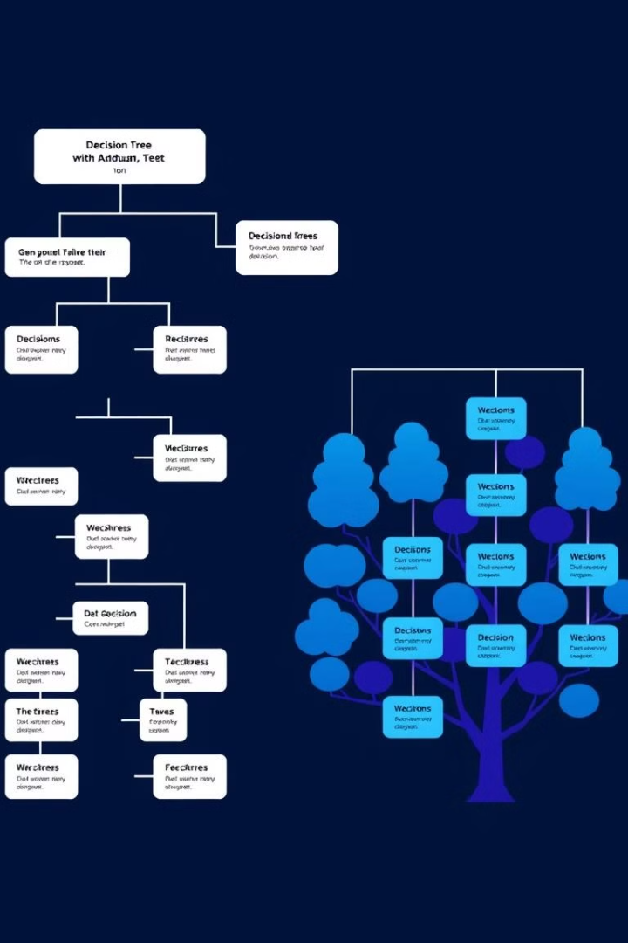
Random Forest Model: Methodology and Performance
1
Model Overview
Random Forest is an ensemble learning method that combines multiple decision trees to improve predictive accuracy and robustness.
2
Feature Importance
The model provides insights into the relative importance of different customer attributes in predicting churn.
3
Performance Metrics
The Random Forest model's performance is evaluated using the same metrics as the Logistic Regression model.

Slide 9

Gradient Boosting Model: Methodology and Performance
1
Model Structure
Gradient Boosting is an iterative ensemble method that combines multiple weak predictive models to create a strong one.
2
Hyperparameter Tuning
The model's hyperparameters, such as learning rate and tree depth, are optimized grid search CV to achieve the best performance.
3
Evaluation Metrics
The Gradient Boosting model's performance is assessed using the same metrics as the previous models.

Slide 10
Comparative Analysis of Model Performance
Accuracy
Precision and Recall
AUC-ROC
Accuracy=TP+TN/FP+FN+TP+TN
Precision=TP+FPTP​
Trade-off between the true positive rate (recall) and the false positive rate (1-specificity) at various threshold settings.
​Accuracy=0.83, 0.86, 0.85
Recall=TP+FNTP​
Precision=0.85
AUC-ROC Score=0.92, 0.93, 0.94
Recall=0.83
Key Finding
1
Tenure
2
Monthly Charges:
3
Total Charges-:
The negative correlation between tenure and churn highlights the value of customer loyalty. Investing in retention strategies, such as personalized offers and excellent customer service, can yield substantial long-term benefits.
Higher total charges might contribute to churn
There's a positive correlation between Monthly Charges and Churn, suggesting that customers paying higher monthly fees are more likely to churn.

Slide 11

Retention Statergy
Personalized Service: Tailor interactions to individual customer needs and preferences.
Exclusive Offers: Provide special discounts, promotions, and early access to new products or services.
Proactive Problem-Solving: Identify and address potential issues before they impact customer satisfaction.
Optimized Marketing Spend: Targeted campaigns can reduce marketing costs and improve ROI.
Notes:
• This capstone project has demonstrated the power of analytics in predicting customer churn in the telecom industry. • We've developed a Gradio app that can check whether a customer is likely to churn or not, based on key customer data. • This app puts our analytical work into practice and makes our churn prediction model accessible to the wider team. • By proactively identifying at-risk customers, we can take steps to address their needs before they decide to leave, which is critical for the long-term success of the business. • This project shows how analytics can drive real business impact in the area of churn prevention.

